Slide 1
Optimizing Wedding Reception Seating Charts
Using Genetic Algorithms
Megan Stiles

Slide 2
Problem
90 wedding guests (excluding the head table) need table assignments
Optimize closeness of the guests sitting at each table
Assumption: People want to sit at a table with the people at the wedding with which they are most closely related.

Slide 3
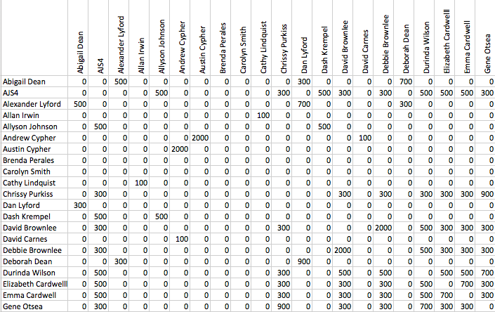
Guest Relational Matrix
Closeness Key:
2000 = spouse/date
900 = sibling
700 = parent/child
500 = cousin
300 = aunt/niece
100 = friend
0 = No Relation
5000 = Bride/Groom

Slide 4

Chromosome/ Fitness Function Design
Chromosome = c (0,1,0,1,0,.....n) for n = 90

Slide 5
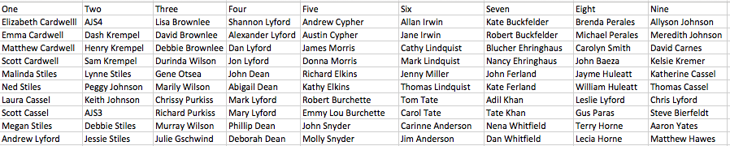
Results

Slide 6
Results Key
Table 1: Bride’s parents, cousins, aunts, uncles
Table 2: Bride’s brother, grandfather, aunts, uncles, and cousins
Table 3: Bride’s aunts, uncles, and cousins
Table 4: Groom’s parents, aunts, uncles, and cousins
Table 5: Friends of Groom and friends of Bride’s parents
Table 6: Friends of Bride, Groom’s uncle, aunt, cousin, friend of groom
Table 7: Friends of Bride
Table 8: Friends of Bride, Friends of Groom
Table 9: Cousins of the Bride, Friends of the Bride, Groom’s Brother (Young Single Table)

Slide 7
Challenges
Guest Relational Matrix
Chromosome Design with multiple constraints

Slide 8
References
Bellows, Meghan and J.D. Luc Peterson, “Finding an Optimal Seating Chart” Neatorama September 18, 2012, http://www.neatorama.com/2012/09/18/Finding-an-Optimal-Seating-Chart/

